Slide 1
Correlation Coefficient of two variable
Huzefa Ayub
​BSc Math(H) Sem 5
Roll-203034-11-0103

Slide 2


Agenda
A
Introduction
Correlation Coefficient for Discrete Random Variables
Correlation Coefficient for Continuous Random Variables
Application of Correlation Coefficient
Summary

Slide 3
Introduction
Correlation Coefficient is a statistical measure of the strength of a linear relationship between two variables. It can range from -1 to 1. A correlation coefficient of -1 describes a negative relation while a correlation coefficient of +1 describes a positive relation. Values at or close to zero indicate no linear relation or weak correlation.

Slide 4
Random Variables chosen for finding correlation can be
Discrete or Continuous

Slide 5
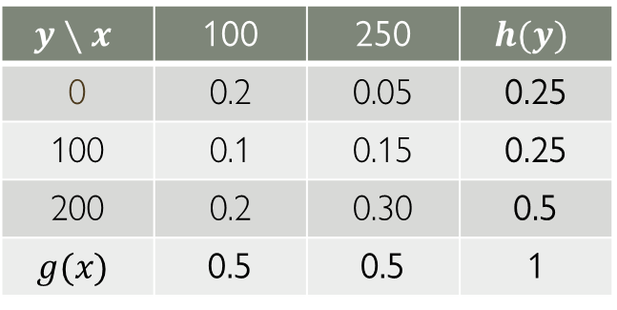
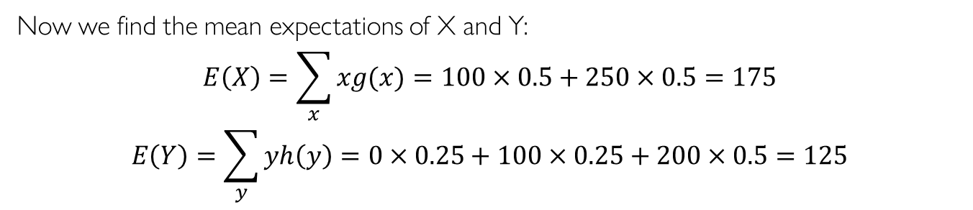
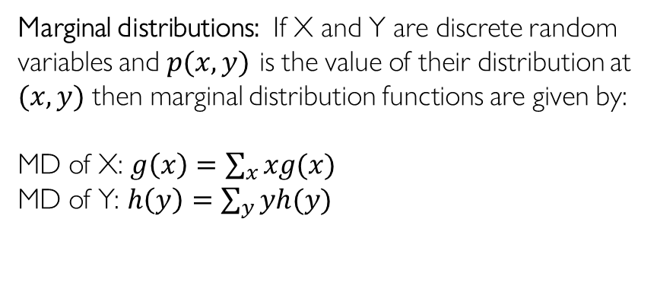
Finding Correlation Coefficient for Discrete Random Variables X and Y
$$y∖x$$ | 100 | 250 | $$h(y)$$
0 | 0.2 | 0.05 | 0.25
100 | 0.1 | 0.15 | 0.25
200 | 0.2 | 0.30 | 0.5
$$g(x)$$ | 0.5 | 0.5 | 1
Marginal distributions: If X and Y are discrete random variables and $p(x,y)$ is the value of their distribution at $(x,y)$ then marginal distribution functions are given by:
MD of X: $g\left(x\right)=\sum_{x}{xg(x)}$
MD of Y: $h\left(y\right)=\sum_{y}{yh(y)}$
Where $g\left(x\right) \& h(y)$ are marginal distributions of X and Y
Now we find the mean expectations of X and Y:
$$E\left(X\right)=\sum_{x}{xg(x)}=100×0.5+250×0.5=175$$
$$E\left(Y\right)=\sum_{y}{yh\left(y\right)=0×0.25+100×0.25}+200×0.5=125$$

Slide 6
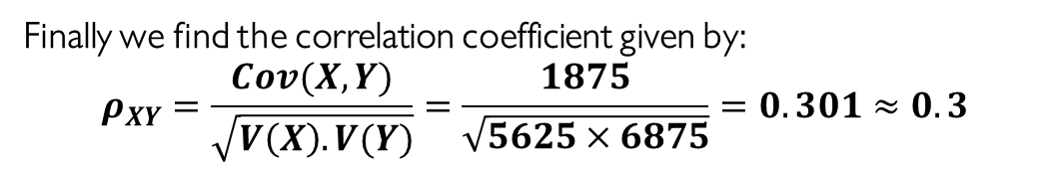
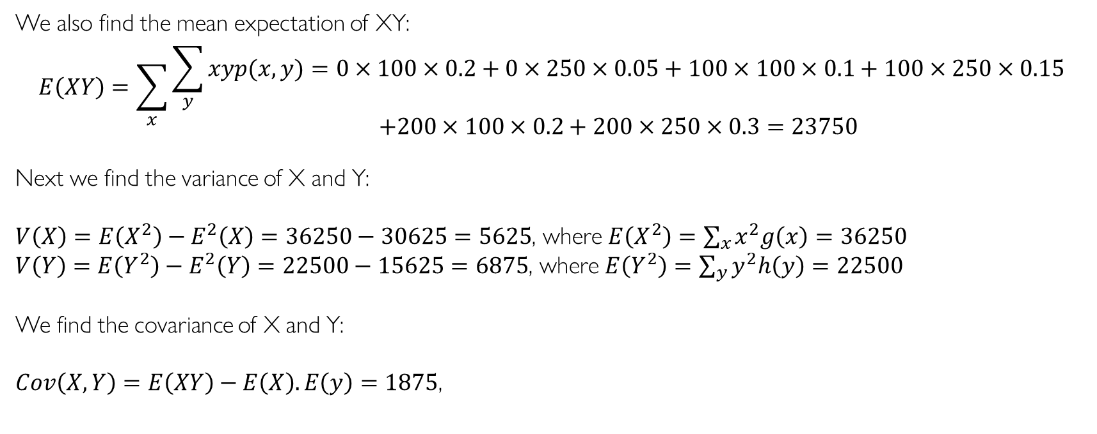
Calculation
We also find the mean expectation of XY:
$$E\left(XY\right)=\sum_{x}{\begin{aligned}\sum_{y}{xyp(x,y)}=0×100×0.2+0×250×0.05+100×100×0.1+100×250×0.15 \\ +200×100×0.2+200×250×0.3=23750\end{aligned}}$$
Next we find the variance of X and Y:
$V\left(X\right)=E\left(X^{2}\right)−E^{2}\left(X\right)=36250−30625=5625$, where $E\left(X^{2}\right)=\sum_{x}{x^{2}g\left(x\right)=36250}$
$V\left(Y\right)=E\left(Y^{2}\right)−E^{2}\left(Y\right)=22500−15625=6875$, where $E\left(Y^{2}\right)=\sum_{y}{y^{2}h\left(y\right)=22500}$
We find the covariance of X and Y:
$Cov\left(X,Y\right)=E\left(XY\right)−E\left(X\right).E\left(y\right)=1875$,
Finally we find the correlation coefficient given by:
$$ρ_{XY}=\frac{Cov(X,Y)}{\sqrt{V\left(X\right).V(Y)}}=\frac{1875}{\sqrt{5625×6875}}=0.301≈0.3$$

Slide 7
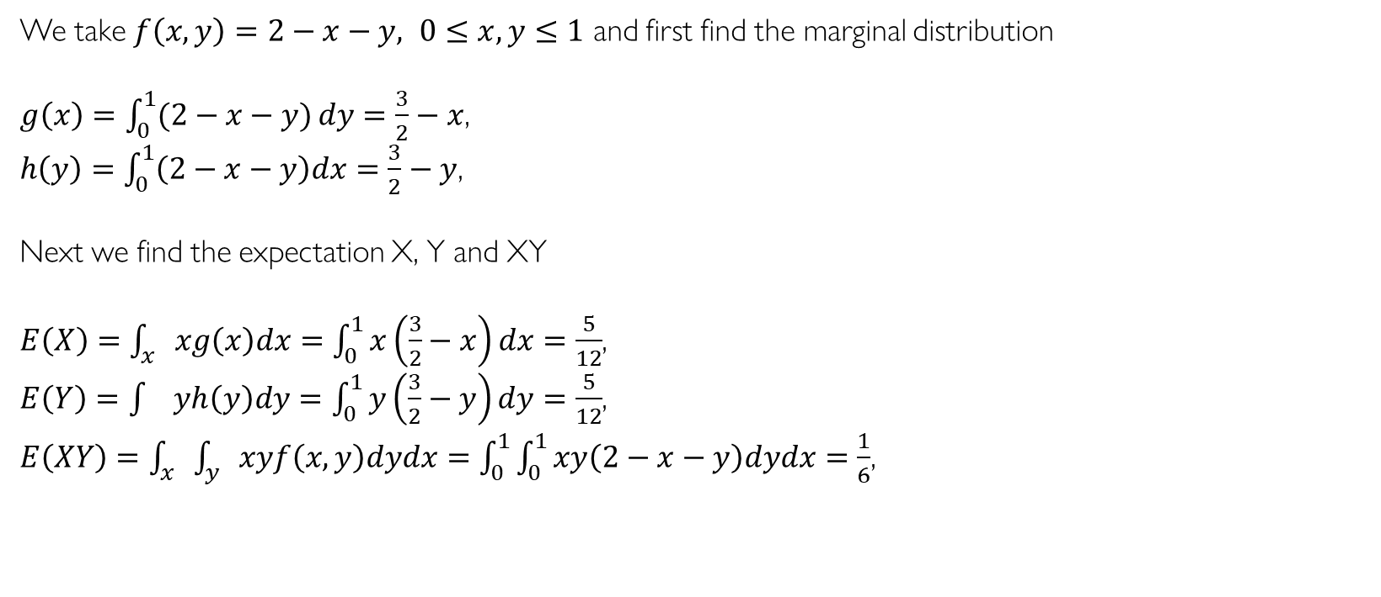
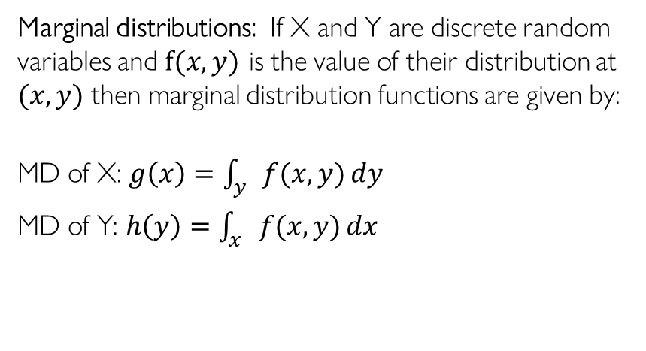
Finding Correlation Coefficient for Continuous Random Variables X and Y
We take $f\left(x,y\right)=2−x−y, 0≤x,y≤1$ and first find the marginal distribution
$g\left(x\right)=\int_{0}^{1}{(2−x−y)}dy=\frac{3}{2}−x$,
$h\left(y\right)=\int_{0}^{1}{\left(2−x−y\right)dx=\frac{3}{2}−y}$,
Next we find the expectation X, Y and XY
$E\left(X\right)=\int_{x}{xg\left(x\right)dx=\int_{0}^{1}{x\left(\frac{3}{2}−x\right)dx}}=\frac{5}{12}$,
$E\left(Y\right)=\int{yh\left(y\right)dy=\int_{0}^{1}{y\left(\frac{3}{2}−y\right)dy}}=\frac{5}{12}$,
$E\left(XY\right)=\int_{x}{\int_{y}{xyf\left(x,y\right)dydx=\int_{0}^{1}{\int_{0}^{1}{xy\left(2−x−y\right)dydx=\frac{1}{6}}}}}$,
Marginal distributions: If X and Y are discrete random variables and $f(x,y)$ is the value of their distribution at $(x,y)$ then marginal distribution functions are given by:
MD of X: $g\left(x\right)=\int_{y}{f(x,y)}dy$
MD of Y: $h\left(y\right)=\int_{x}{f(x,y)}dx$

Slide 8
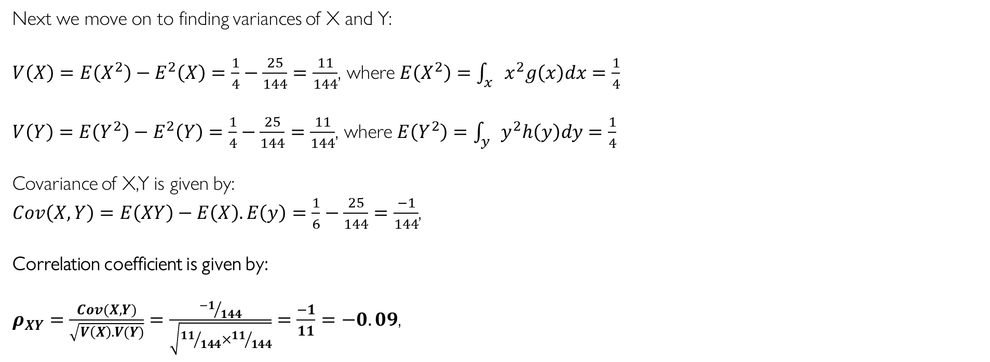
Calculations
Next we move on to finding variances of X and Y:
$V\left(X\right)=E\left(X^{2}\right)−E^{2}\left(X\right)=\frac{1}{4}−\frac{25}{144}=\frac{11}{144}$, where $E\left(X^{2}\right)=\int_{x}{x^{2}g\left(x\right)dx=\frac{1}{4}}$
$V\left(Y\right)=E\left(Y^{2}\right)−E^{2}\left(Y\right)=\frac{1}{4}−\frac{25}{144}=\frac{11}{144}$, where $E\left(Y^{2}\right)=\int_{y}{y^{2}h\left(y\right)dy=\frac{1}{4}}$
Covariance of X,Y is given by:
$Cov\left(X,Y\right)=E\left(XY\right)−E\left(X\right).E\left(y\right)=\frac{1}{6}−\frac{25}{144}=\frac{−1}{144}$,
Correlation coefficient is given by:
$ρ_{XY}=\frac{Cov(X,Y)}{\sqrt{V\left(X\right).V(Y)}}=\frac{{−1}/{144}}{\sqrt{{11}/{144}×{11}/{144}}}=\frac{−1}{11}=−0.09$,

Slide 9
Correlation coefficients are used in science and in finance to assess the degree of association between two variables, factors, or data sets.
Application of Correlation Coefficient

Slide 10
Summary
Correlation coefficients are used to assess the strength of associations between data variables.
The statistical significance of a correlation can be calculated from the correlation coefficient and the number of data points in the sample, assuming a normal population distribution.

Slide 11
Resources
F
https://amath.colorado.edu/faculty/vdukic/4570/week5_handout_2020.pdf
https://www.investopedia.com/terms/c/correlationcoefficient.asp
https://www.statisticshowto.com/probability-and-statistics/statistics-definitions/marginal-distribution/
Google Chrome

Slide 12
Thank you
Huzefa Ayub
BSc Math(H), Sem 5
Roll- 203034-11-0103

